Slide 1
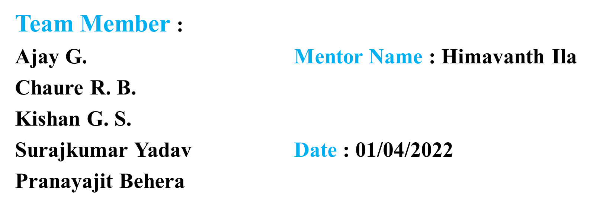
cO2 Emission of car engine

Slide 2
Business Problem
To model the CO2 emissions as a function of several car engine features.

Slide 3
Objective
Fundamental goal here is to model the CO2 emissions as a function of several car engine features.

Slide 4
Project Flow
Data set details
EDA
Model Building
Model Evaluation
Feedback
Deployment

Slide 5
Data Set Details
In this data set there are 12 Column and 7385 Rows.
In that way this problem has 12 following variables:
make, car brand under study.
model, the specific model of the car.
vehicle_class, car body type of the car.
engine_size, size of the car engine, in liters.
cylinders, number of cylinders.

Slide 6
Data set details
transmission, “A: for ‘Automatic’, “AM” for ‘Automated Manual’, “AS” for ‘Automatic with Select Shift’, “AV” for ‘Continuously Variable’, “M” for ‘Manual”.
fuel_type, “X” for “Regular gasoline”, “Z” for ‘Premium gasoline’, “D” for “Diesel”, “E” for ‘Ethanol (E85)’, “N” for ‘Natural gas’.
fuel_consumption_city, City fuel consumption ratings, in liters per 100 kilometers.
fuel_consumption_hwy, Highway fuel consumption ratings, in liters per 100 kilometers.

Slide 7
Data set details
fuel_consumption_comb(I/100km), the combined fuel consumption rating (55% city, 45% highway), in L/100 km.
fuel_comsumption_comb(mpg), the combined fuel consumption rating (55% city, 45% highway), in miles per gallon (mpg).
co2_emissions, the tailpipe emissions of carbon dioxide for combined city and highway driving, in grams per kilometer.

Slide 8
Data set Details
Duplicated Rows : (1112,12)
Null Values : No Null Value Found
Data Set Contain 3 types of data:
int64 : -cylinders, fuel_consumption_comb(mpg), co2 emissions.
float64 : engine_size, fuel_consumption_city, fuel_consumption_hwy, fuel_consumtion_comb (1/100km)
object : make, model, vehicle_class, transmissions, fuel_type

Slide 9
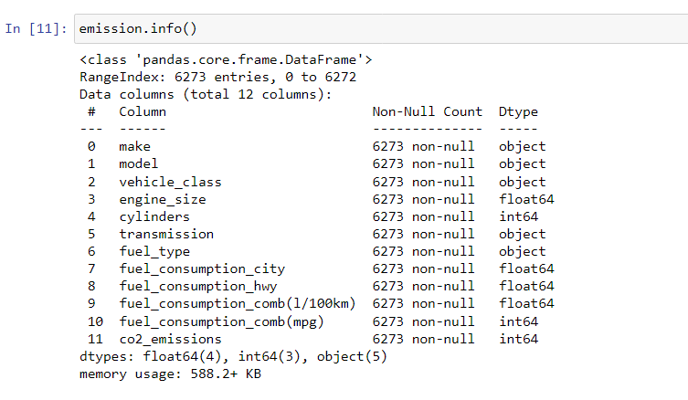

Slide 10
